Slide 1
What to Expect:
The Audit Process
A grower-focused overview from your auditor
Muser Consulting, LLC | Third-Party Independent Auditor
Sustainable WA | 2026 Registration Kickoff

Slide 2
Who Is the Auditor?
Third-party independent auditors — we are here to help, not to penalize
Muser Consulting, LLC
How You Get to Us
Your Sustainable WA Auditing Partner
1
Grower applies & pays via QLBS platform
We are 3rd party independent auditors
We are NOT the IRS, State, City, or County
We are here to help growers and support the program
We contact growers by phone or email to schedule the audit
Nathaniel Helligso handles fees and platform access, then passes your information to us
2
Nathaniel (WA Winegrowers) processes and shares your info
3
Muser Consulting contacts you to schedule the audit
4
Audit is conducted — doc review, site visit, interview
5
Audit Report sent; corrections due by Nov. 15
Sustainable WA | 2026 Registration Kickoff | Muser Consulting, LLC

Slide 3
Audit Timeframe: What Period Are We Looking At?
The certification cycle runs from after Harvest to beginning of the next Harvest
Nov 2025
(Post-Harvest)
Mar 1, 2026
Jun–Sep 2026
Aug 2026
(Pre-Harvest)
Cycle begins
Applications open
Audit window
Cycle ends
2026 Certification Cycle (After Harvest 2025 through beginning of Harvest 2026)
Key Dates for 2026
What This Means For Your Documents
March 1: Applications open
May 15: Application window closes
June 1 – Sept 1: Audit window
Nov. 15: Corrective actions due
Dec. 31: Certificates issued
We are looking for documentation covering the period from after your 2025 Harvest (approximately November 2025) through the beginning of your 2026 Harvest (approximately August 2026).
This means gathering records, logs, and reports that span roughly a full year of vineyard operations.
Sustainable WA | 2026 Registration Kickoff | Muser Consulting, LLC

Slide 4
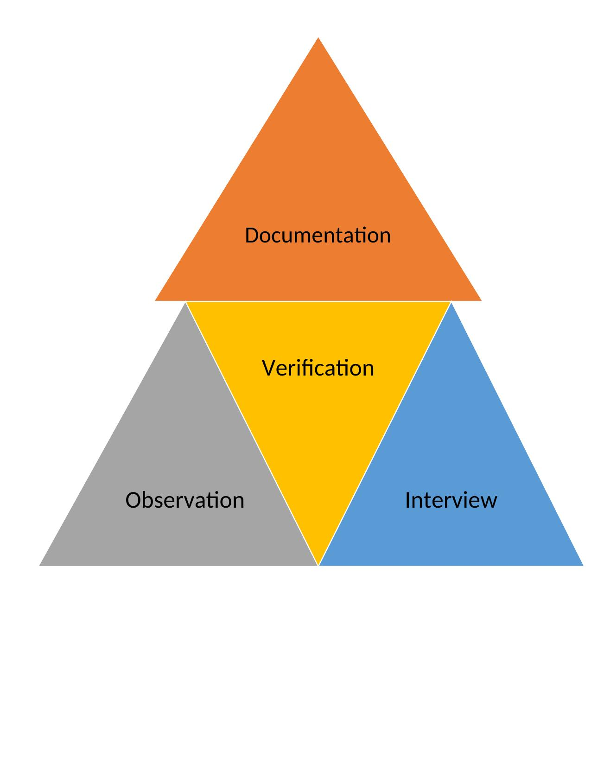
How We Verify: Onsite Audit
Every onsite audit requirement is verified through one or more of these three approaches
Documentation | Written
Written records, reports, plans, and logs. Examples: business plan, PUR, soil tests, vintage records, employee handbook, invoices, calibration logs.
Observation | Visual
Physical walk-through of the vineyard and facilities. We look at: break rooms, PPE storage, chemical storage area, irrigation system, equipment, and the vineyard itself.
Interview | Verbal
Conversation-based verification. We ask questions about your practices, knowledge of the industry, and decisions made during the certification cycle.
Sustainable WA | 2026 Registration Kickoff | Muser Consulting, LLC

Slide 5
How We Verify: Desk Audit
A Desk Audit is conducted entirely through documentation review — no site visit is required
Documentation | Primary Method
All verification is done remotely through written records submitted by the grower. Documents are reviewed against the self-assessment responses chapter by chapter. Examples: business plan, PUR, soil tests, vintage records, employee handbook, invoices, calibration logs.
No Site Visit | Documentation Only
A Desk Audit does not include a physical site visit. There is no vineyard walk-through, and no visual inspection of facilities, equipment, or storage areas. All requirements are assessed solely through submitted documentation.
Interview | Remote / Optional
The employee/workforce interview requirement does not apply to a Desk Audit. If clarification is needed on submitted documents, the auditor may follow up by phone or email — but no formal interview is conducted.
Sustainable WA | 2026 Registration Kickoff | Muser Consulting, LLC

Slide 6
Preparing for Your Onsite Audit
The better prepared you are, the smoother audit day will go
1
Use the Audit Prep Checklist
2
Gather Documents in One Place
Available at the WA Grower Meeting — March 25, 2026. The checklist walks through every chapter with examples of what to gather. Note the key words on each item: Written, Document, Visual, or Interview.
Collect all written records, plans, reports, and logs in an easily accessible folder or binder before audit day. Digital files in a shared folder work well too.
3
Assign a Key Person
4
Know Your Guaranteed Requests
Designate a key employee or 3rd party consultant to manage the audit process. Having one point of contact reduces confusion and keeps things moving.
The following are required post harvest in September – November. These are Final numbers covering the entire Audit/Certification Cycle and are not collected during the onsite visit: Water use, PUR (Pesticide Use Report), Cumulative PUR, quantities of NPK nutrients (Nitrogen, Phosphorus, and Potassium), and Total Water Use.
Sustainable WA | 2026 Registration Kickoff | Muser Consulting, LLC

Slide 7
Audit Day: What to Expect
The audit has two parts — typically a documentation review first, then a vineyard tour. Order may vary based on conditions (see note below).
Part 1 | Documentation Review
Part 2 | Vineyard Tour
Location: Office, farmhouse, or any location where documents and the self-assessment can be reviewed comfortably
We will go through your self-assessment responses together
Written plans and records will be reviewed chapter by chapter
Interview questions will be asked throughout
Bring your laptop or device if your records are digital
Location: Walk-through of the vineyard and operational areas
Visual observation of facilities, equipment, and practices
PPE storage, chemical storage, mixing/loading area
Break rooms, restrooms, outdoor lunch areas
Irrigation system, sprayer equipment
Vineyard floor, trellis, buffer zones, and vineyard layout
Additional interview questions asked as we walk
Employee/Worker Interviews: the auditor is required to interview 15% of the total workforce onsite during the audit
Note on Order: When temperatures are forecast to exceed 90°F, the auditor may reverse the order — conducting the Vineyard Tour first and the Documentation Review second. This ensures employee interviews are completed before workers are released under Washington State’s heat rule (workers must be sent home once temperatures reach 95°F).
THEN
Sustainable WA | 2026 Registration Kickoff | Muser Consulting, LLC

Slide 8
After the Audit: What Happens Next
You will receive an Audit Report — missing documents can still be submitted
1
Audit Report Sent
2
Guaranteed Requests
The auditor will complete an Audit Report via Word and send it to the Grower via email, and will include any documentation that was missing at time of Audit. These documents will be listed as "Corrective Actions" that the Auditor needs to verify the scores in the Self Assessment
Every report will include a request for:
- PUR (Pesticide Use Report) and Cumulative PUR
- Quantities of NPK: Nitrogen, Phosphorus, and Potassium
- Total Irrigation Water Used
These are Final numbers that must cover the entire Audit/Certification Cycle and are accepted only after Harvest.
3
Deadline: November 15
4
Sharing Your Documents
Growers have from the date the Audit Report is received until November 15 to provide any missing documents. You do not need to wait — submit as you gather them.
Submit all at once or individually. Share via:
- Email to the auditor
- Upload into QLBS: “Details Summary” tab under “File Upload”
- Shared Google Drive folder
- Shared Dropbox folder
5
File Forwarded for Certification
6
Final Certification Decision
Once complete, the auditor sends an email to both the Grower and the Certifier forwarding the completed file to WA Winegrowers for finalization of certification.
Certification decisions are made by Sustainable WA only — not by the auditor. Certificates are issued by December 31.
Sustainable WA | 2026 Registration Kickoff | Muser Consulting, LLC

Slide 9
The Audit Prep Checklist: 9 Chapters at a Glance
Available at the March 25 Kickoff Event — use it to prepare before audit day
1
Business Practices & Risk Management
6
Soil & Nutrient Management
Not audited — discussed with grower
Soil management plan, tissue analysis, NPK application totals*
2
Human Resources
7
Pest Management
Written policies, training records, PPE
Pest plans, PUR and Cumulative PUR (Corrective Action), monitoring records, weed/bird/vertebrate plans
3
Vineyard Establishment & Acquisition
8
Materials Handling
Site history, soil tests, planting material, irrigation layout
Chemical storage, mixing area, sprayer calibration, applicator licenses
4
Viticulture
9
Whole Farm Ecosystem & Community
Pruning, canopy management, vintage records, harvest data
Farmscape map, ecosystem plan, neighbor relations, community involvement
5
Water Management
Water quality reports, irrigation records, pump efficiency, water use totals*
* NPK totals, cumulative PUR and water use are accepted ONLY after Harvest — must include data for the full current certification cycle.
Sustainable WA | 2026 Registration Kickoff | Muser Consulting, LLC

Slide 10
Tips From Your Auditor
Small steps before audit day make a big difference
Do This
Watch Out For
Use time and date stamps on all photos
Gather documents into one accessible folder before audit day
Assign one key person to manage the audit process
Know your Guaranteed Requests — PUR, Cumulative PUR, NPK totals, and Total Water Use are submitted after harvest
Submit corrective action documents individually as you get them — no need to wait for everything
Use shared Google Drive or Dropbox for easy document sharing
Log seminars, grower meetings, and educational events attended (applies to Ch. 2 and Ch. 4)
Plans that exist but are not in writing — verbal knowledge is helpful but written documentation is required for most chapters
Pesticide applicators without current licenses on file
Watch List material use without a completed Justification Form
Sustainable WA | 2026 Registration Kickoff | Muser Consulting, LLC

Slide 11
Questions?
We're here to help you succeed.
Muser Consulting, LLC
Program Questions?
Your Auditor
WA Winegrowers — Program & Operations
Contact will be made by phone or email
after your application is submitted.
heather@muserconsulting.com
1.209.810.1966
Text messages are always welcome!
Nathanial Helligso
Nathanial@wawinegrowers.org
509.881.1970
Sustainable WA | 2026 Registration Kickoff

Slide 12






Thank You!
Sponsored By
Program Partners
Special Thanks
Questions? Contact Nathanial Helligso | Nathanial@wawinegrowers.org

